Slide 1
Murder on the Beat: A Brief Analysis of the Relationship Between a State’s Economic/Social Factors and Homicide Rates.
By Joan, Niko, Darrious, and Aaron K.

Slide 2
Hypothesis
It is commonly assumed that states with strong economic factors such as wealthier populations, lower unemployment rates, and lower poverty rates are safer, meaning lower violent crime rates.
Formal Hypothesis: If states have high median income, a higher cost of living, low unemployment rates, and low poverty rates, then they should therefore be safer and have low rates of homicides.

Slide 3
Motivation & Summary
We set out to investigate whether this assumption would hold true.
We asked this question because we believed that this assumption is partly formed from our pre-existing notions about the benefits of wealth.
What we found is there is barely any correlation between the indicators of wealth and homicide we chose, but there is a moderately positive correlation between indicators of poverty and homicide rates.

Slide 4
Overview
This project explores the relationship between a state’s homicide rates in the year 2019 to four economic and social factors.
These factors include:
Median Household Income
Unemployment Rate
Poverty Rate
Median Home Value
Notes:
The year 2019 was selected because the data was well-documented and readily available, as well as the most recent.

Slide 5




Programs/Modules Utilized:
Python
Pandas Module
Matplotlib Module
NumPy

Slide 6
Where did we get our data from?
Monthly unemployment data for all 50 states is released publically by the Bureau of Labor Statistics
https://www.bls.gov/opub/ted/2020/unemployment-rates-in-15-states-were-lower-than-the-3-point-5-percent-u-s-rate-in-december-2019.htm
Median Income Data from the US Census Bureau (broken down by state)
https://www.census.gov/data/tables/time-series/demo/income-poverty/historical-income-households.html
Annual homicide data from FBI
https://crime-data-explorer.fr.cloud.gov/api
Median House Value
https://www.experian.com/blogs/ask-experian/research/median-home-values-by-state/
Poverty Rate Data
https://www.census.gov/library/visualizations/interactive/2019-poverty-rate.html

Slide 7
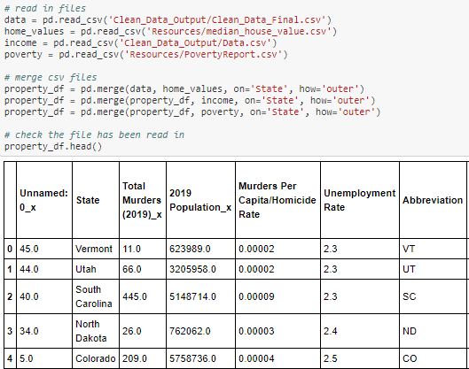
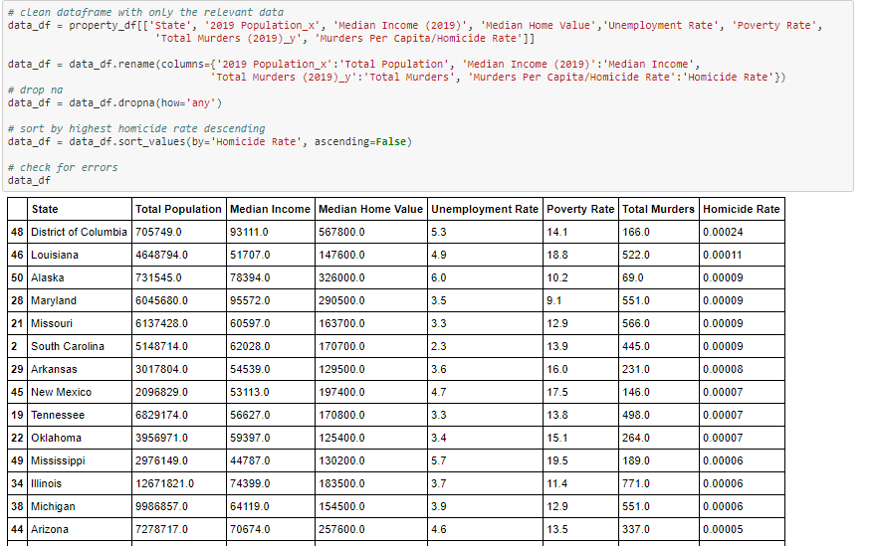
Clean Up Process (Reading & Merging)

Slide 8
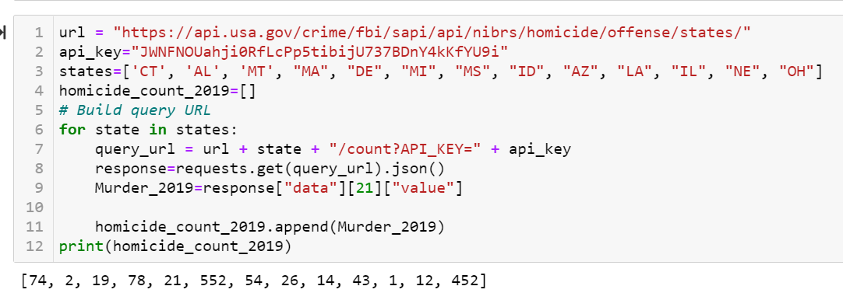
Clean Up (API’s)
At first, we considered using an API from the FBI’s website.
Initial efforts were promising.

Slide 9
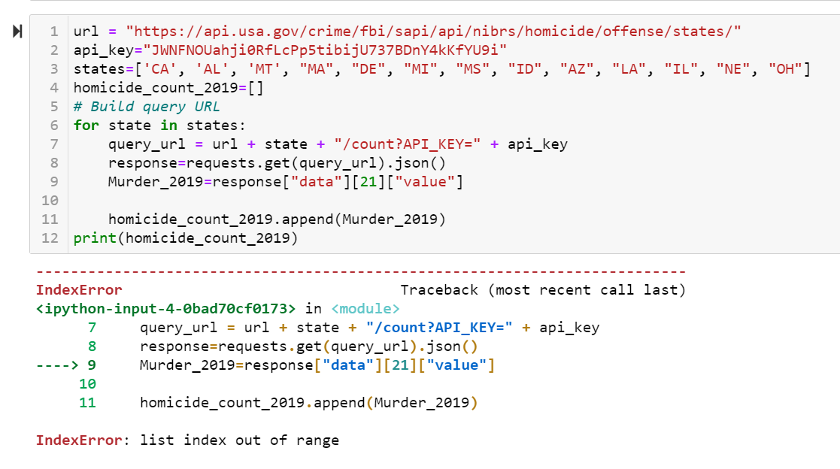
Clean Up (API’s)
However, as we continued to the API code would sometimes return “IndexErrors” or would have different homicide counts for the same state.
Because of this, we opted to use a .csv file from the FBI’s website instead.
Notes:
Florida homicide data was submitted to the FBI through the “Bureau of Indian Affairs” and was vastly underreported (i.e. Florida did not have 1 homicide in 2019).
Limited homicide data for 2019 was available for Alabama.

Slide 10
Analysis

Slide 11
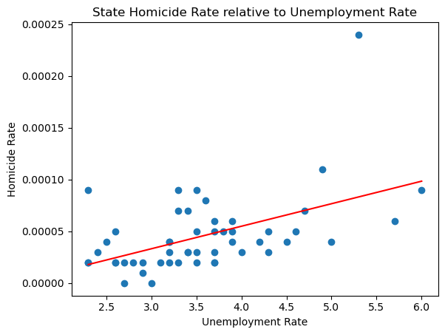
Unemployment Rate (%) vs Homicide Rates (%)
Correlation coefficient of 0.50 indicates a moderately positive relationship between a state’s unemployment rate and homicide rate, implying that states with higher unemployment rates generally have higher rates of homicide.

Slide 12
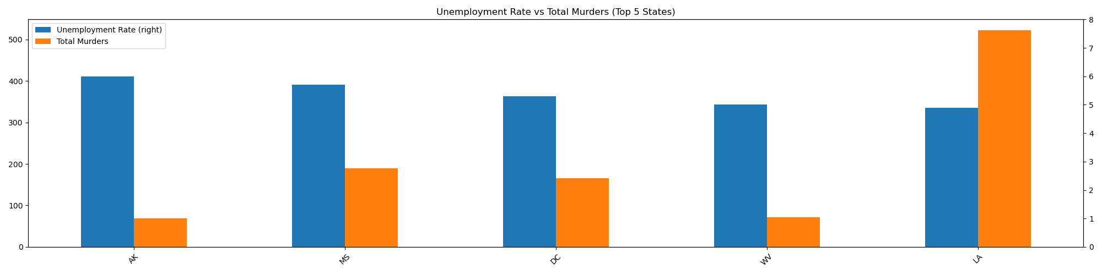
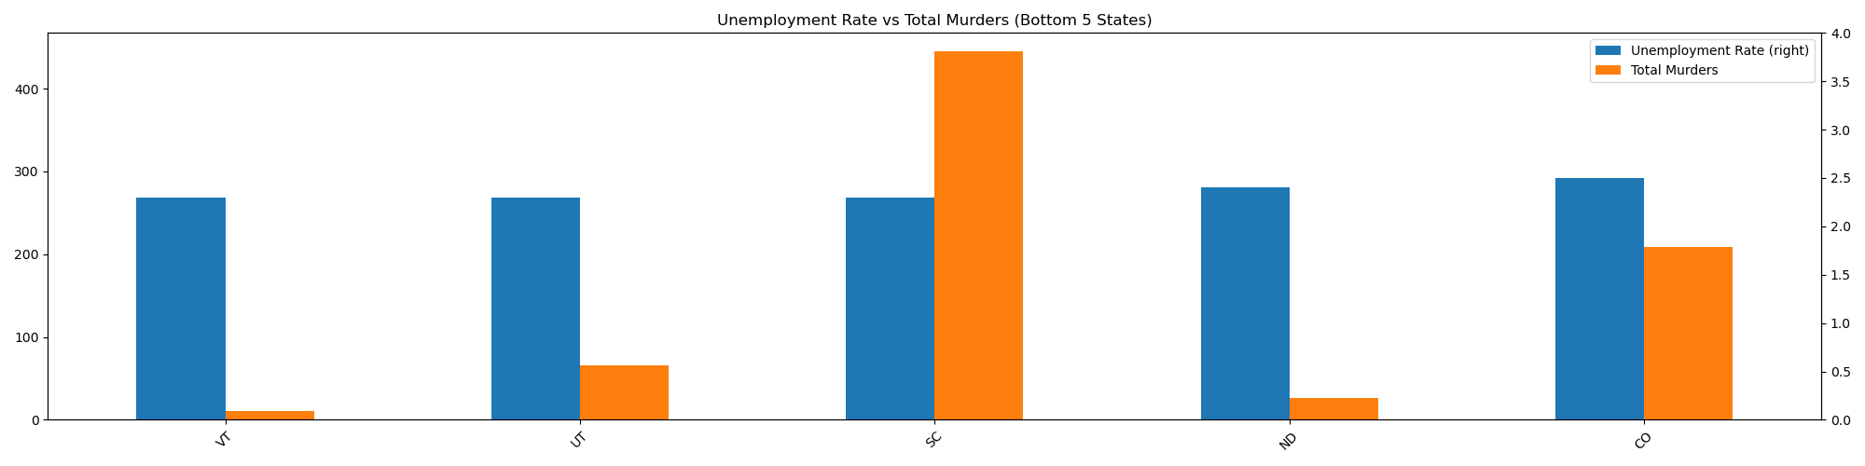
Unemployment Rate (%) vs Homicides

Slide 13
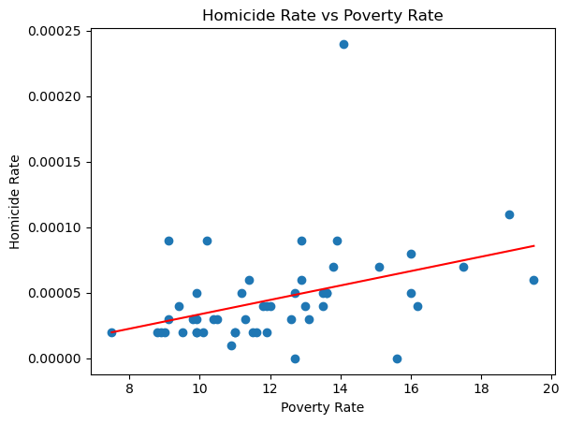
Poverty Rate (%) vs Homicide Rates (%)
The r squared was: 0.15
Correlation coefficient of 0.40 indicating a moderate relationship between poverty rates and homicide rates, partially confirming our hypothesis of less wealthy states having higher homicide rates.
In other words, as poverty rates increase it would appear that homicide rates increase as well.
Notes:
Similar to the unemployment rate comparison, we also ran a linear regression against poverty rates for each state in 2019 and ultimately calculated an R^2 of 0.15, so there was limited dispersion in the data. Perhaps most importantly, and the most relatable to our hypothesis was the calculated correlation coefficient of 0.40 which indicated a moderate relationship between a state’s poverty rate and homicide rates, and at least partially confirmed our hypothesis that poorer states generally have higher rates of homicide.

Slide 14
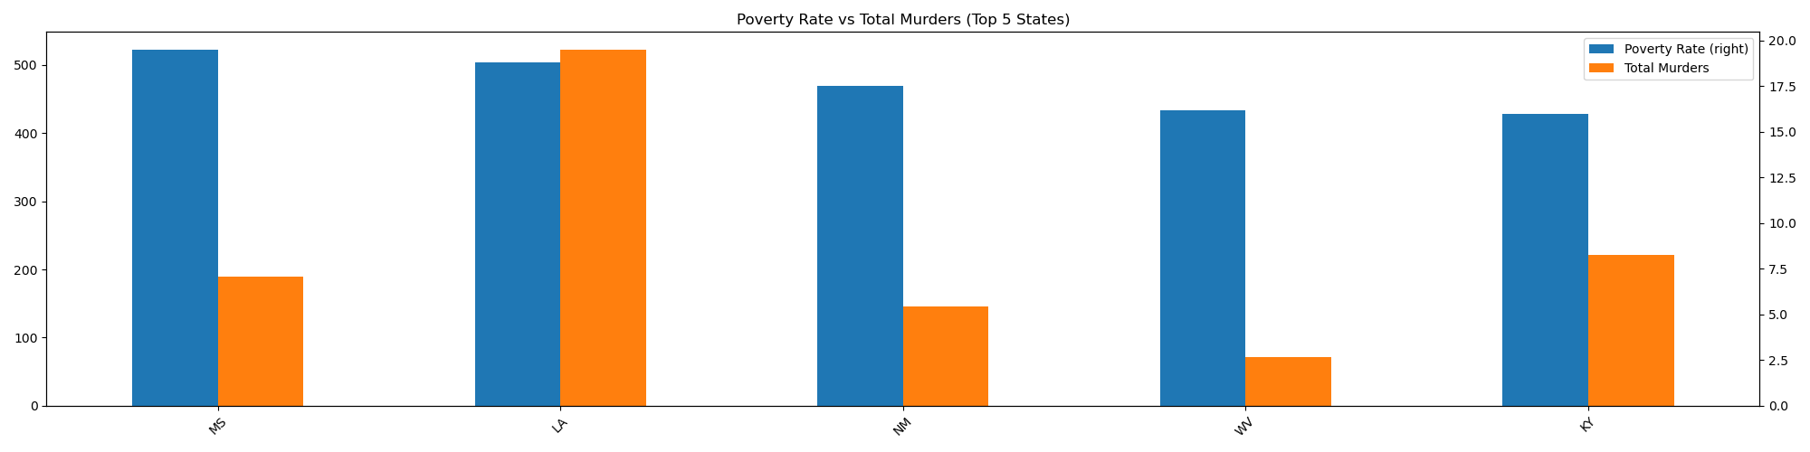
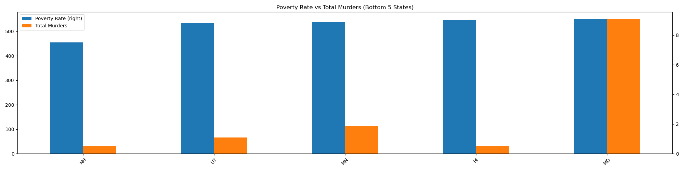
Poverty Rate (%) vs Homicides
Notes:
We thought an interesting perspective would be to graph multibar plots of raw homicide counts vs Poverty rates for the top five and bottom five states ranked by poverty rates. The only apparent outlier in the top 5 is Lousiana, while poverty rates amongst the other members of the top 5 and homicide counts seem to be

Slide 15
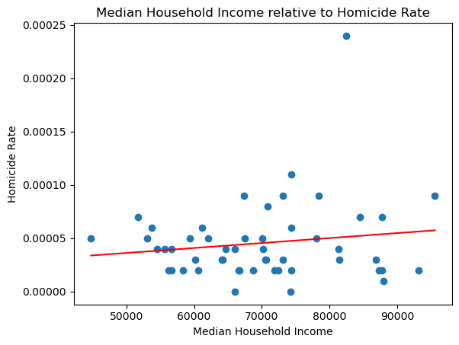

Median Income ($) vs Homicide Rates (%)
The relationship between median household income vs homicide rate has a 0.05 correlation coefficient indicating an inconclusive relationship.
The r-squared is .002 which is another indication that variance of median income isn’t conclusive enough.

Slide 16
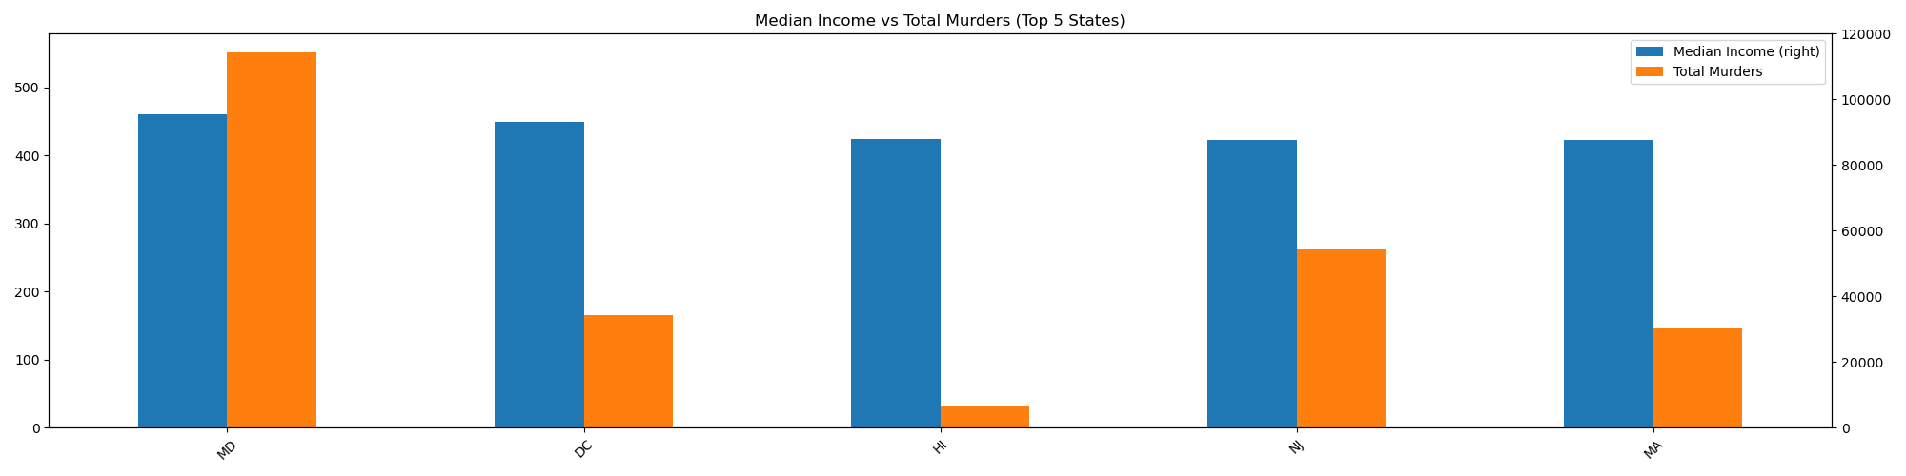
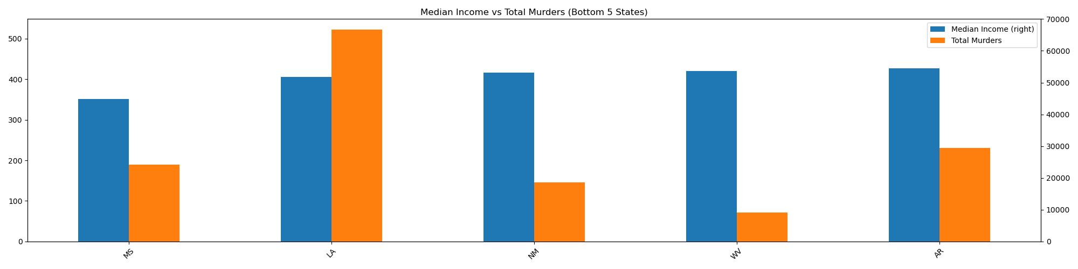
Median Income ($) vs Homicides
Notes:
Median income among the top five is consistent
MD(top 5) homicides counts exceeds the median income which can be seen as an outlier
LA (bottom 5) homicides counts exceeds the median income which can be seen as an outlier

Slide 17
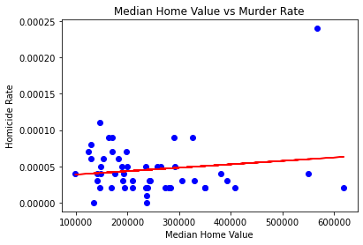
Median Home Value ($) vs Homicide Rate (%)
The correlation coefficient between the two factors is 0.143, indicating that the correlation between the median home value and homicide rate is insignificant.
Our hypothesis assumed there would be a negative correlation between the median home value and homicide rates. Meaning that as the median home values increased, we expected to see the homicide rates to drop significantly. However, the data does not indicate this is the case.
Notes:
Perhaps unsurprisingly, we got similar results when plotting homicide rates against median home value. There was a insignificant positive correlation. Because the correlation is insignificant, it’s nearly impossible to say anything about the two factors to each other. However, we do know several of the factors that affect home price (population density for example) also drive up homicide rates.

Slide 18
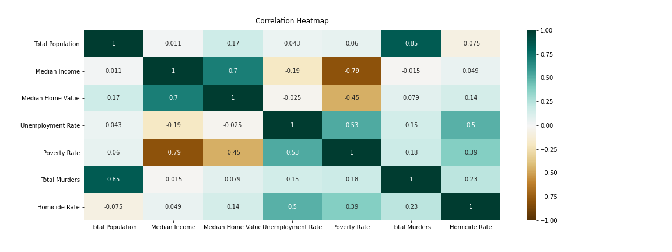
Correlation Matrix

Slide 19
Discussion/Conclusions
Confirmed:
Considering the calculated ~0.5 correlation coefficient, it would appear that state’s with higher rates of unemployment generally have higher rates of homicide.
Albeit a weak correlation coefficient of ~0.4, it would appear that there is somewhat of a positive relationship between a state’s poverty rate and homicide rates, indicating that poorer states generally have higher homicide rates.
Noting that these conclusion are correlative, and not proof of causation, it would appear that there is a positive relationship between both a state’s unemployment/poverty rates and homicide rates.
Inconclusive:
The correlation coefficients for median household income and median home value per state were .05 and .143 respectively, indicating no relationship between either variables and the state’s homicide rate. In other words, the results neither confirmed or rejected the hypothesis that median income and home value are negatively correlated with a state’s homicide rates.
Notes:
Formal Hypothesis: If states have high median income, a higher cost of living, low unemployment rates, and low poverty rates, then they should therefore be safer and have low rates of homicides.
Confirmed
States with higher rates of unemployment generally have higher rates of homicide.
State’s poverty rate and homicide rates are moderately positively correlated indicating that poorer states generally have higher homicide rates.
Inconclusive
Median household income and median home value per state were found to have little to relationship homicide rates, with respective CC .05 and .143 In other words, the results neither confirmed or rejected the hypothesis

Slide 20
Post Mortem
Why we chose 2019?
2019 was a fairly strong year in terms of economics(i.e. low unemployment, high GDP growth).
A year like 2020 may yield different results as there was an economic decline and social stressors.
Economic variables were limited to unemployment, poverty, median income, and median home value.
Further analysis could be done on other variables that potentially influence homicides such as gun ownership, drug markets, or availability of mental health services by state.
The scope of our project was limited to the crime to homicides, but it could be of interest to test the correlation of these variables against more financially motivated crimes such as theft, fraud, or tax evasion.
Notes:
We chose 2019 because it was the most recent data set

Slide 21
Questions?

